Slide 1
PROJECT INTRODUCTION
SDG 6 Clean Water And Sanitation
Access to safe water and sanitation are human rights.
A person without access to improved drinking water is forced to rely on sources such as surface water, unprotected and possibly contaminated wells, or vendors selling water of unverifiable provenance and quality.
Without improved sanitation people have no choice but to use inadequate community toilet or to practise open defecation.
Here we have tried to analyse the data for the state of Telangana to recommend for any improvement which can be made.

Slide 2
Methodology
MS Excel/ Google Spreadsheet is used for data visualisation and for other purpose.
3D mapping is done using Bing Maps.
Five Datasets have been taken into consideration here.
Exhaustive Data Preparation and cleaning is being done throughout the datasets of 5 relevant excel sheets.

Slide 3
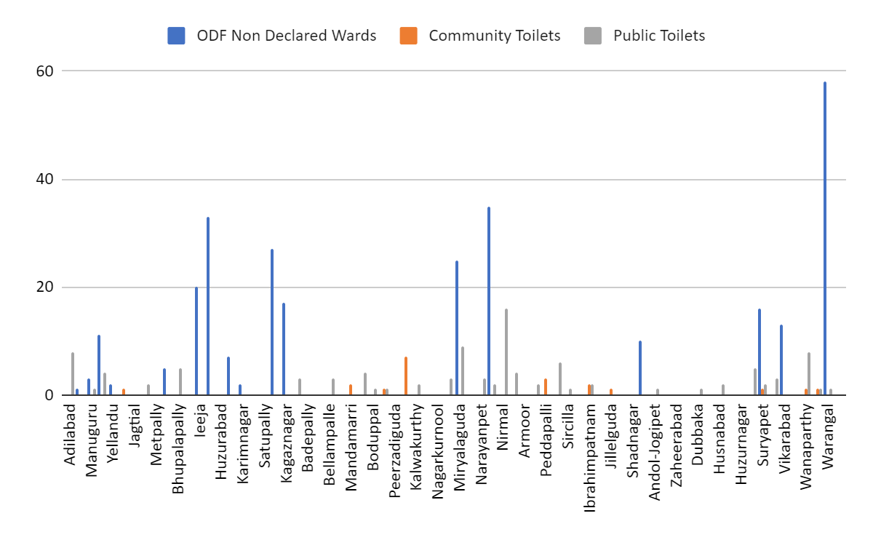
Only nine(9) Cities have community toilets and 10 Cities have “She” toilets.
Almost all cities of districts Jogulamba Gadwal, Kamareddy , Karimnagar don’t have Toilets at all.
One of the reason seems that the districts where there are sufficient Public Toilets,there is less consideration on installing new Community - She toilets.
Notes:
ODF - Open defecation free

Slide 4
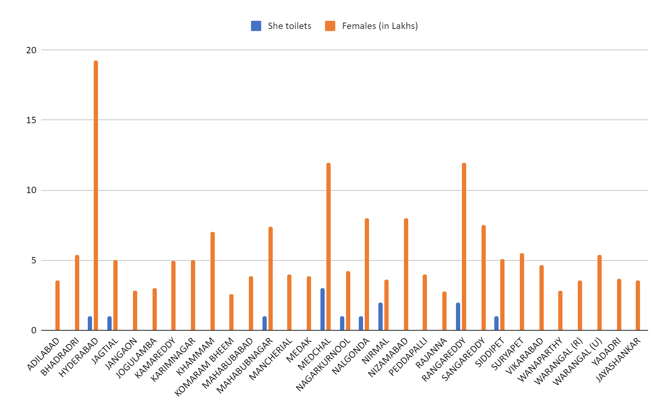
Figure showing the plot of number of She toilets vs. Total Female Population in various cities.
The places where female population is high is not having adequate no. of She Toilets (e.g., Districts)

Slide 5
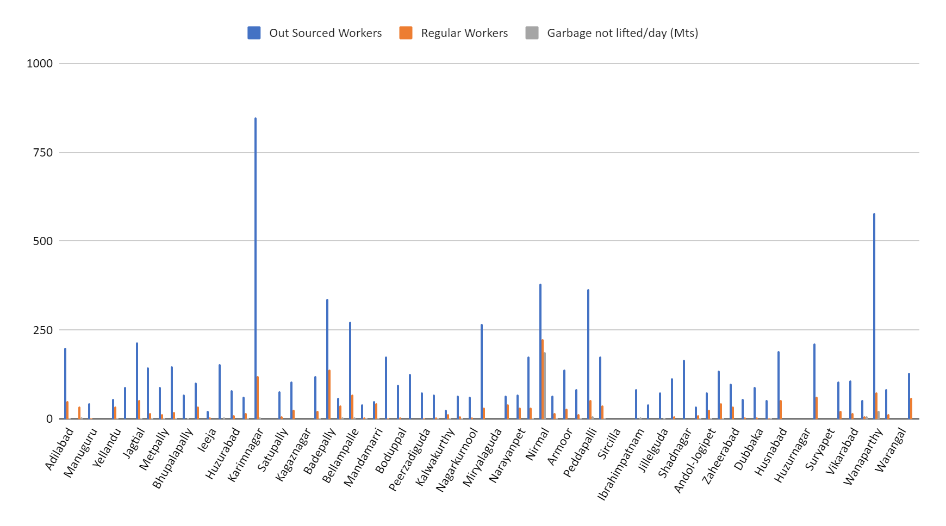
Number of workers should be increased in area where total garbage generated is not completely collected.
The Urban Planning department really needs to balance the no. of outsourced workers and that of regular workers since one can’t depend on regular either outsourced workers solely.

Slide 6
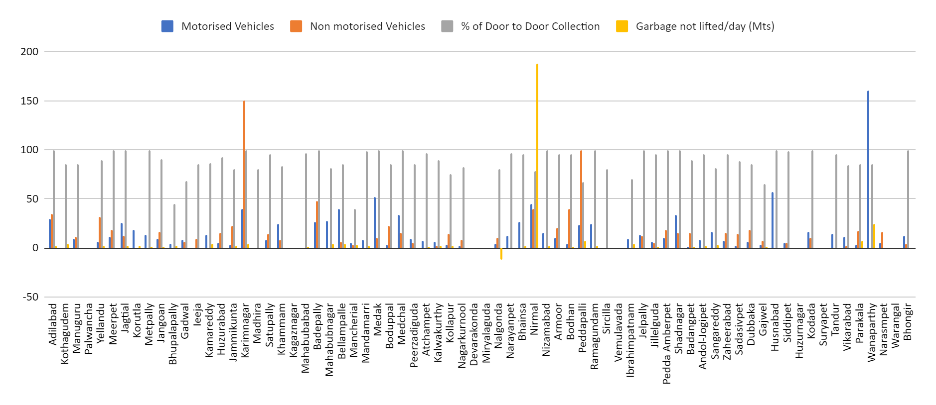
Figure plots the relationship between Motorised Vehicle, Non Motorised Vehicle, percentage door to door collection and Garbage not lifted per day.
Motorised vehicles should be increased.
In areas With door collection less than 100% number of vehicles should be increased.
In areas where garbage in not lifted number of vehicles should be increased.

Slide 7
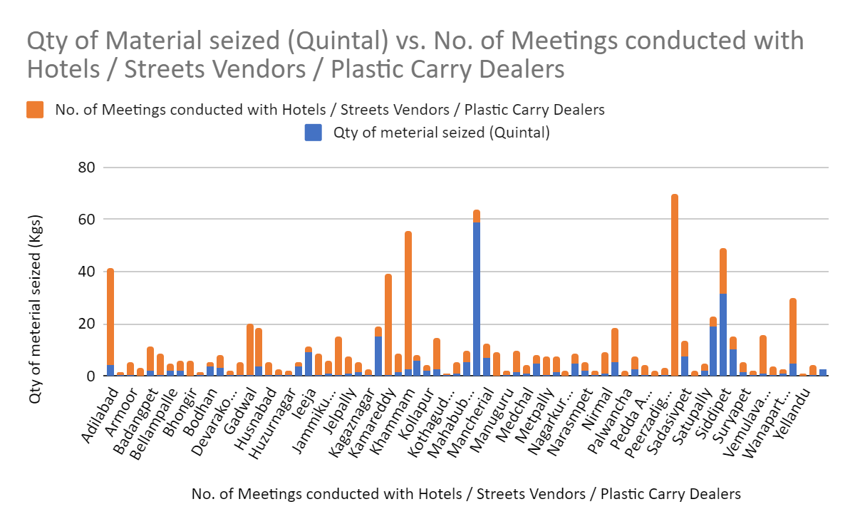
From the above figure we can say that if there seems to be a decrease in quantity of plastic seized when the number of meetings with hotels ,street vendors is increased.
So, more awareness programmes in the state will definitely show good response.

Slide 8
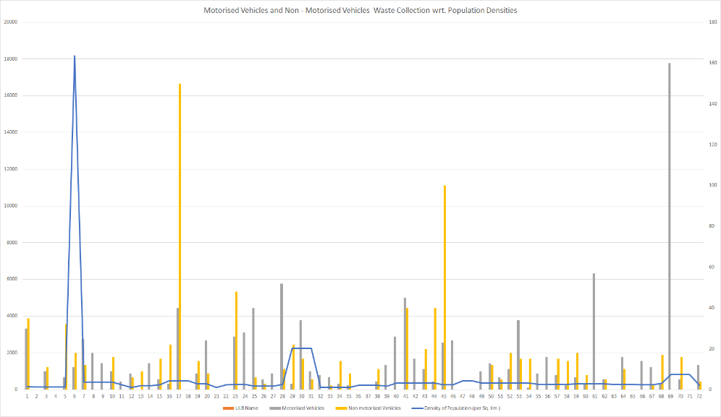
The figure depicting use of Motorised Vehicle vs Non Motorised Vehicle w.r.t. Population Density
It is clearly visible that Non Motorised Vehicle is excessively used which should me regulated.
It is found that there is an Outlier in ULBs from Hyderabad.

Slide 9
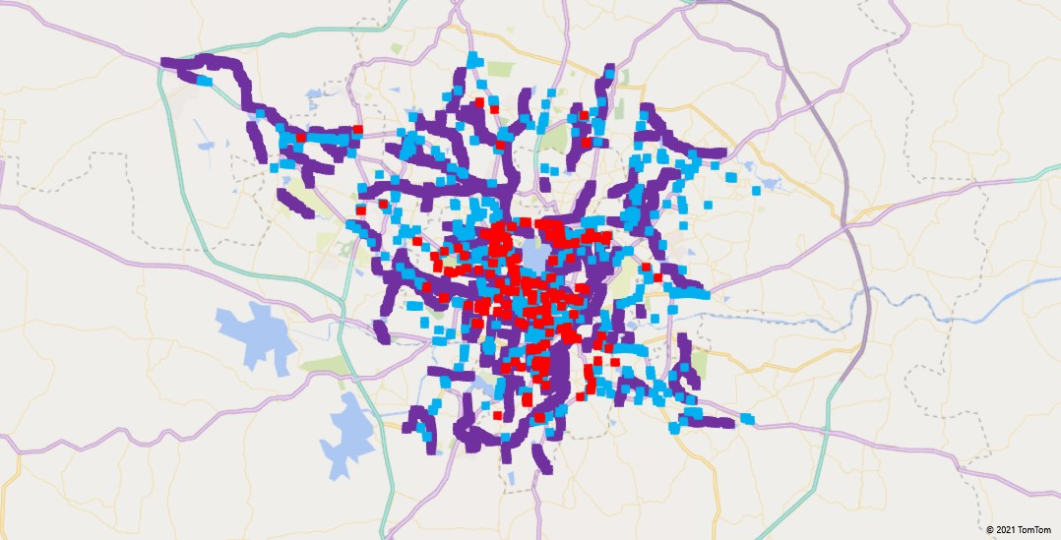
Colour code:
Sea Green - Toilets.
Red - Water Stagnation.
Violet - Nalas.
The heat map plot gives the relationship between spread of Toilets, Nalas and Water Stagnation throughout the map.
From the figure we can observe that the areas which have water stagnation have low level of drainage i.e., Nalas.
Majority of toilets are placed in the vicinity of water stagnation areas hence we can see a lack of drainage facility and an area to improve.

Slide 10
Recommendation/ Results/ Conclusion
Almost all cities of districts Jogulamba Gadwal, Kamareddy , Karimnagar have no toilets, so there should be immediate action for making of the same.
For women and girls, going out for toilets, can leave them vulnerable to abuse and sexual assault. Hence number of SHE Toilet is a must in the city and village as well.
In areas With door collection less than 100% number of vehicles should be increased especially motorised for faster disposal.
More awareness programmes in the state for use of plastic should be made because the data shows that awareness with vendors and hotels decrease the overall use of plastic.
Increase in No. of community toilets will be one of the task which ensure healthy surrounding
Technological improvement is required for Garbage Collection as it is mostly done by non - motorised vehicle.
For women and girls, going out for toilets, can leave them vulnerable to abuse and sexual assault. Hence no of SHE Toilet is a must in the city and village as well.
The government may install ATM-style water dispensers that provide clean water to the whole community.
Piped household water connections and household toilets with adequate sewage systems or septic tanks.

Slide 11
Thank You.

